Slide 1
Sprint 4
Melissa Abad, Thomas Farrell,
Derek Night

Slide 2
Challenges you faced
There were many challenges our group faced during our project. One was having so many objects be in the room like tables and chairs.
The robot would also move out of place without being touched by any object because the floor isn't flat which was most noticeable when doing the figure 8 five times.

Slide 3
Roles of each team member
Each of our team member had a different role. Melissa was the documenter. She documented the expected and observed output of each test.
Derek was the coder who made the code for the robot for the sprints.
Thomas came up with algorithm and the flowchart.

Slide 4
What have you learned about software engineering
I have learned that there is a lot that goes into software engineering and how important planning is.
I also learned how important it is to keep track of tests and make test plans.

Slide 5
What would you do differently
I would plan a little more before running certain tests. This way we would not have so many failed tests.
I would also record more of the trials.

Slide 6
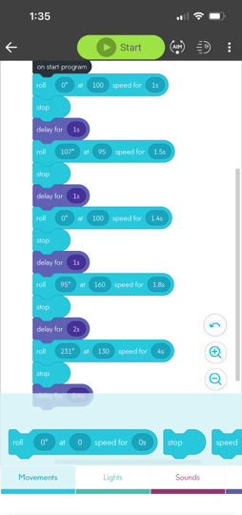
Algorithm and Block Code for Agility Sprint
Start
Turn 45º left
Go forward until stop
Turn 90º right
Go forward until stop
Turn 90º left
Go forward until stop
Turn 90º right
Go forward until stop
Turn 135º right
Maximum throttle towards pins (markers)
End

Slide 7
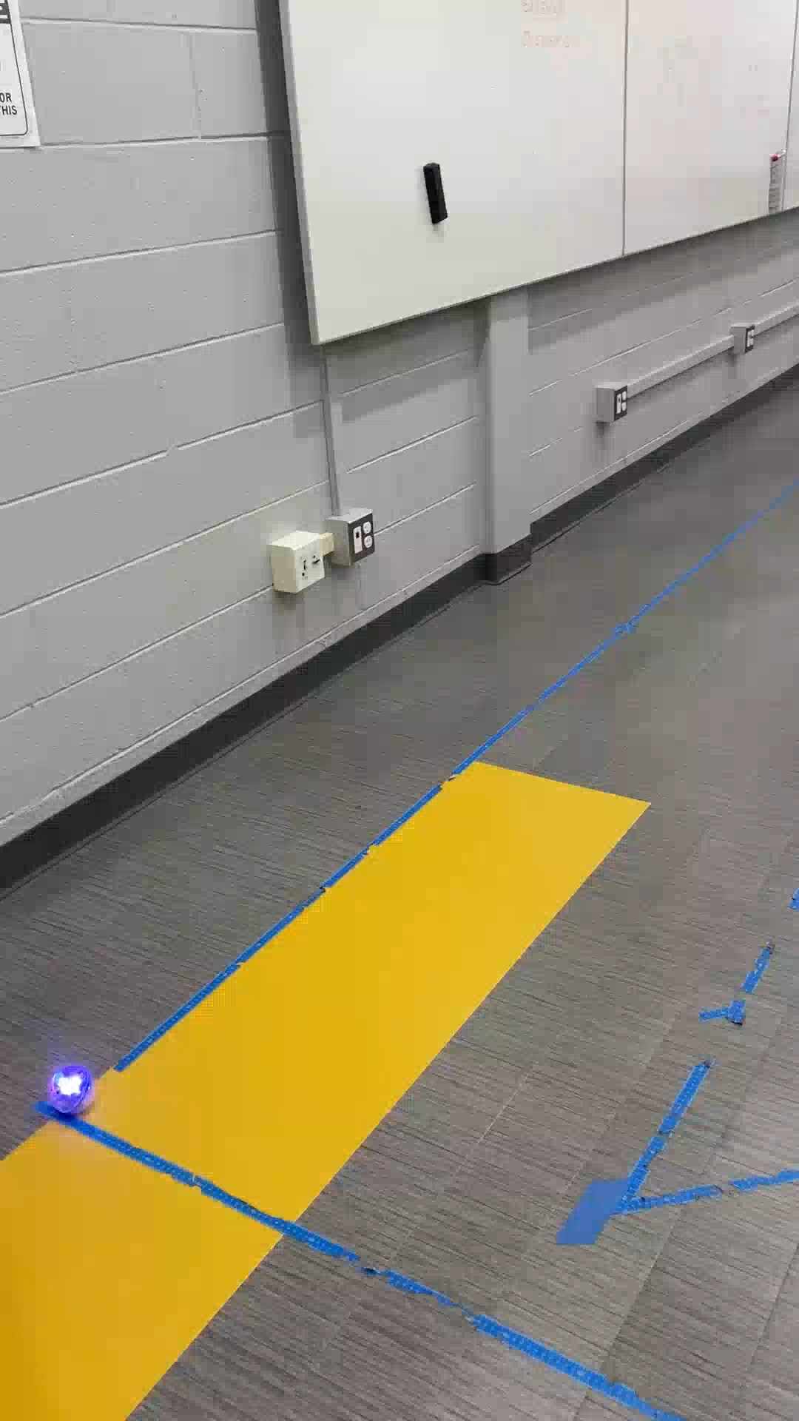
Endurance Sprint Video

Slide 8
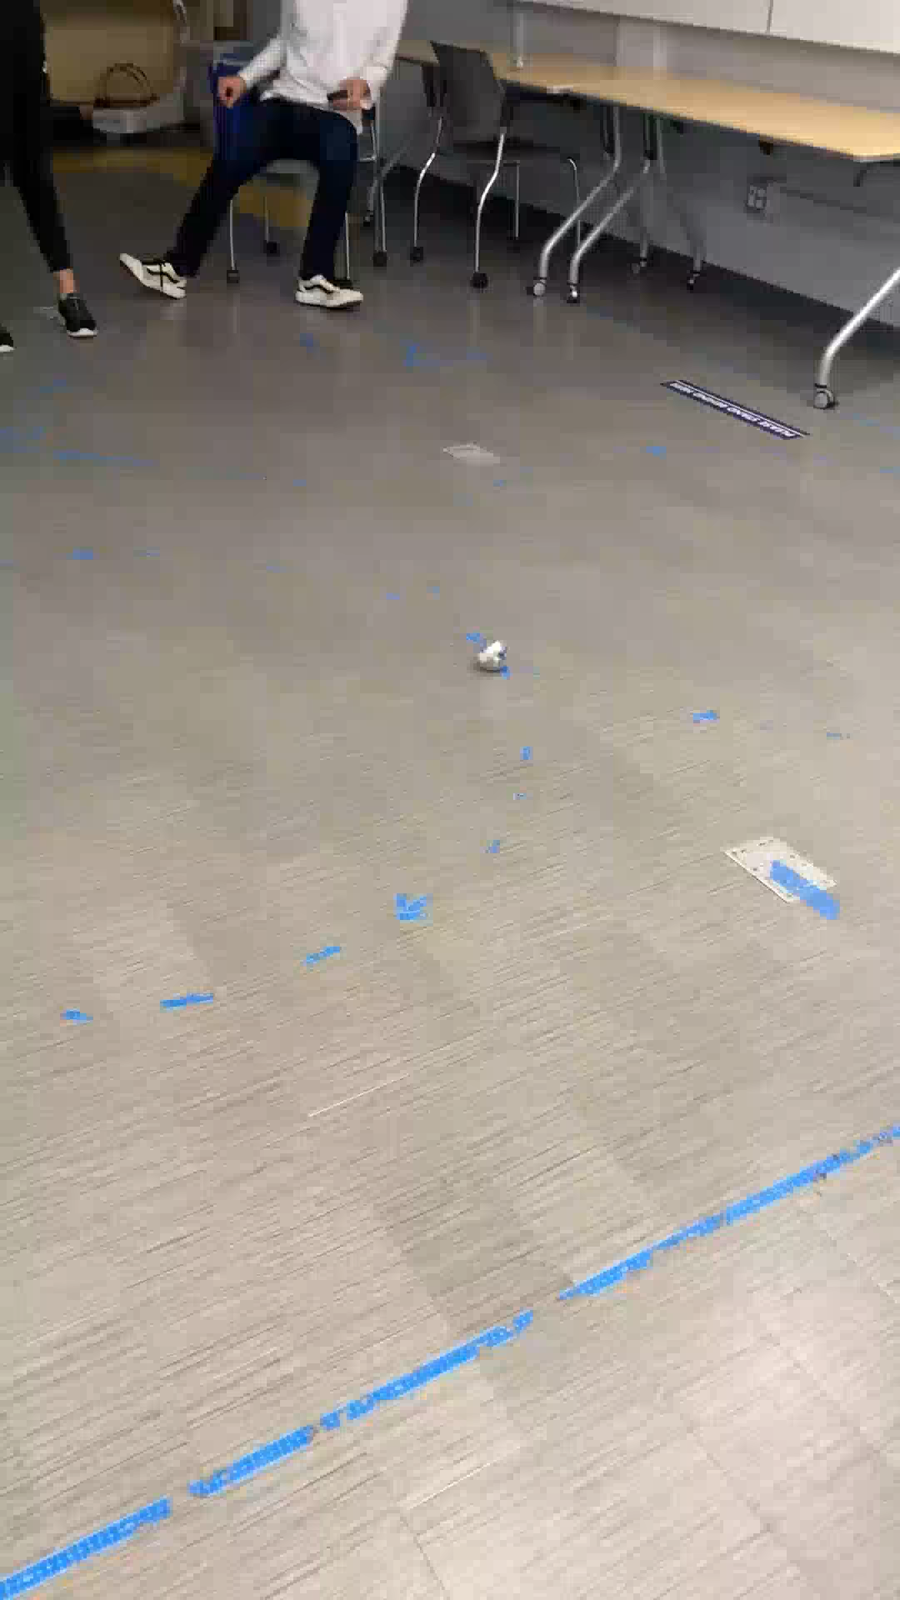
Accuracy Sprint Video

Slide 9
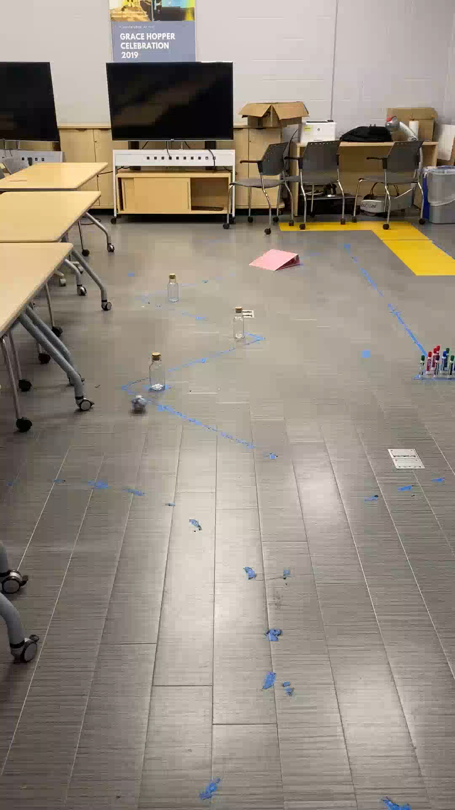
Agility Sprint Video

